Slide 1
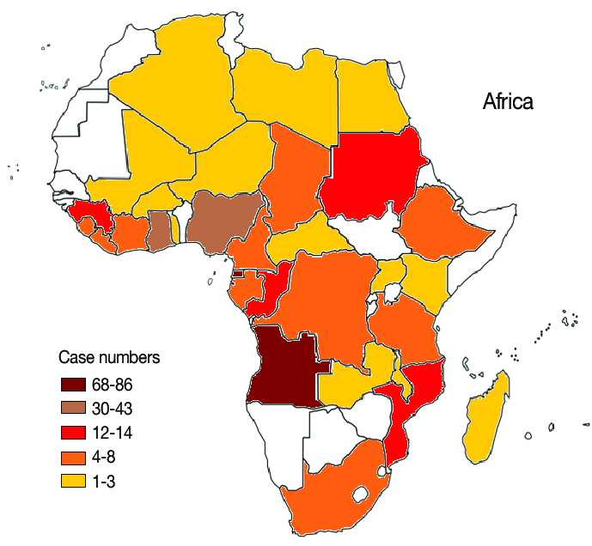
Malaria In Africa
Presentation by:
Ian Wanjohi
Lavina Kathambi
Diana Luvandale
Heather Mataruse

Slide 2
AGENDA
Problem Context
Problem Breakdown
Data Analysis
Observations
Solution

Slide 3
PROBLEM CONTEXT
UNICEF reports that Malaria kills a child under five years every two minutes. Globally , the WHO African region has been affected by Malaria which has led to over 384, 000 preventable malaria deaths according to WHO Regional Director for Africa, Dr. Matshidiso Moeti.
This calls for action since there are several challenges faced in the prevention of the disease such as:
The parasite that causes malaria is developing resistance to the drug
The mosquito vector is developing resistance to the insecticides
With data on possible infection rates, pharmaceutical companies would be prepared to produce the right amount of medication to treat cases in the early stages to serve the community.

Slide 4
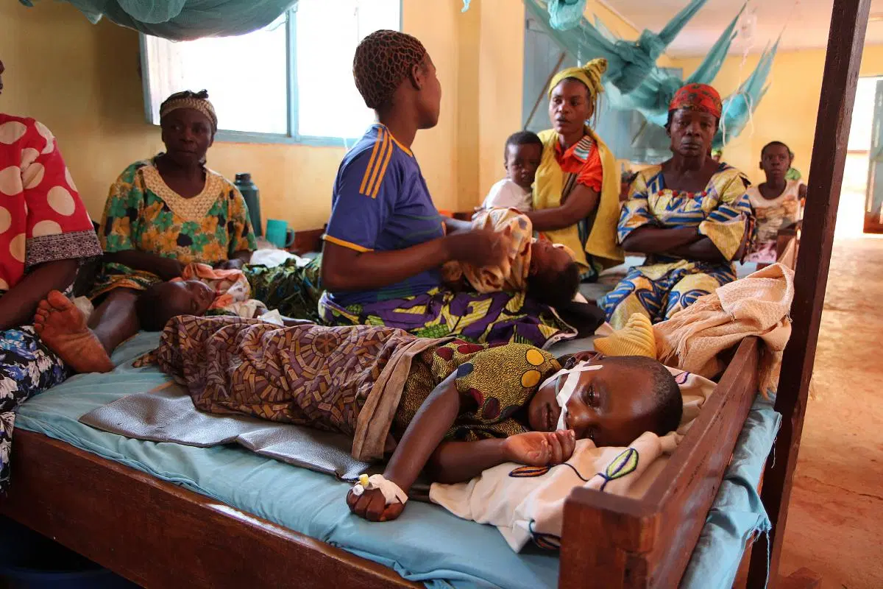
Problem Statement
With 94% of global malaria cases in the WHO African Region which is an estimated 290 million cases and 409,000 deaths[7] over the past ten years, how can we use AI-driven solutions to predict the possible number of malaria cases ,so that Governments and Health Institutions can use our analysis and findings to drive better data-driven decisions on ways to mitigate the issue?

Slide 5
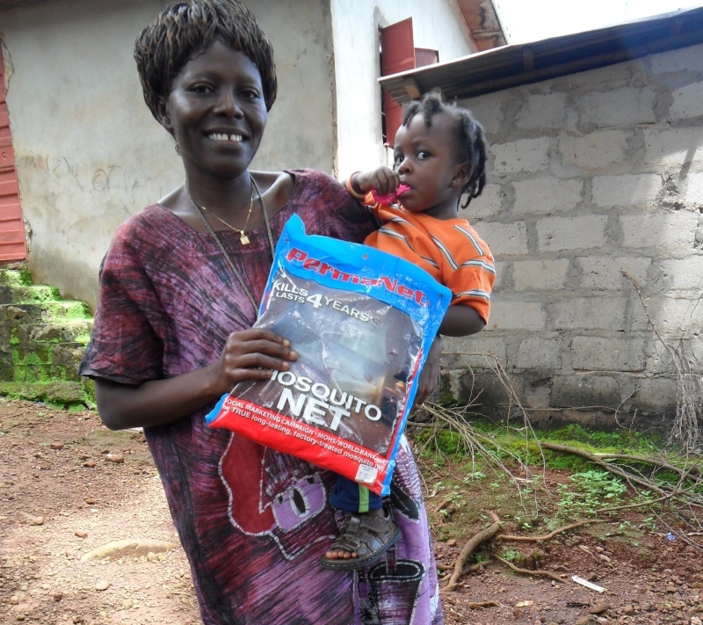
Analysis Questions
Which country in Africa has the highest number of Malaria cases?
Which year had the highest number of malaria cases?
What is the correlation between the incidences of malaria and malaria cases reported?
What is the predicted number of malaria incidences ?

Slide 6
Solution Artefact
Our solution is an AI model that predicts the number of people that will be affected by Malaria in the following year when data is inputted into the model
This model will help the government know the amount of medicine that is needed to be manufactured because of the exact number of people that are affected
Furthermore it will help the government plan about the steps that are needed to be taken to prevent malaria

Slide 7
Data Cleaning Strategies
Dropping null values to remove outliers that would interfere with our analysis
Checked the types of data to ensure consistency across columns
Dropped unwanted columns that would not be relevant during the analysis
Replaced missing values with average values to avoid skewing the results of the analysis
Changed non numerical values to numerals so as to help with the modelling.

Slide 8
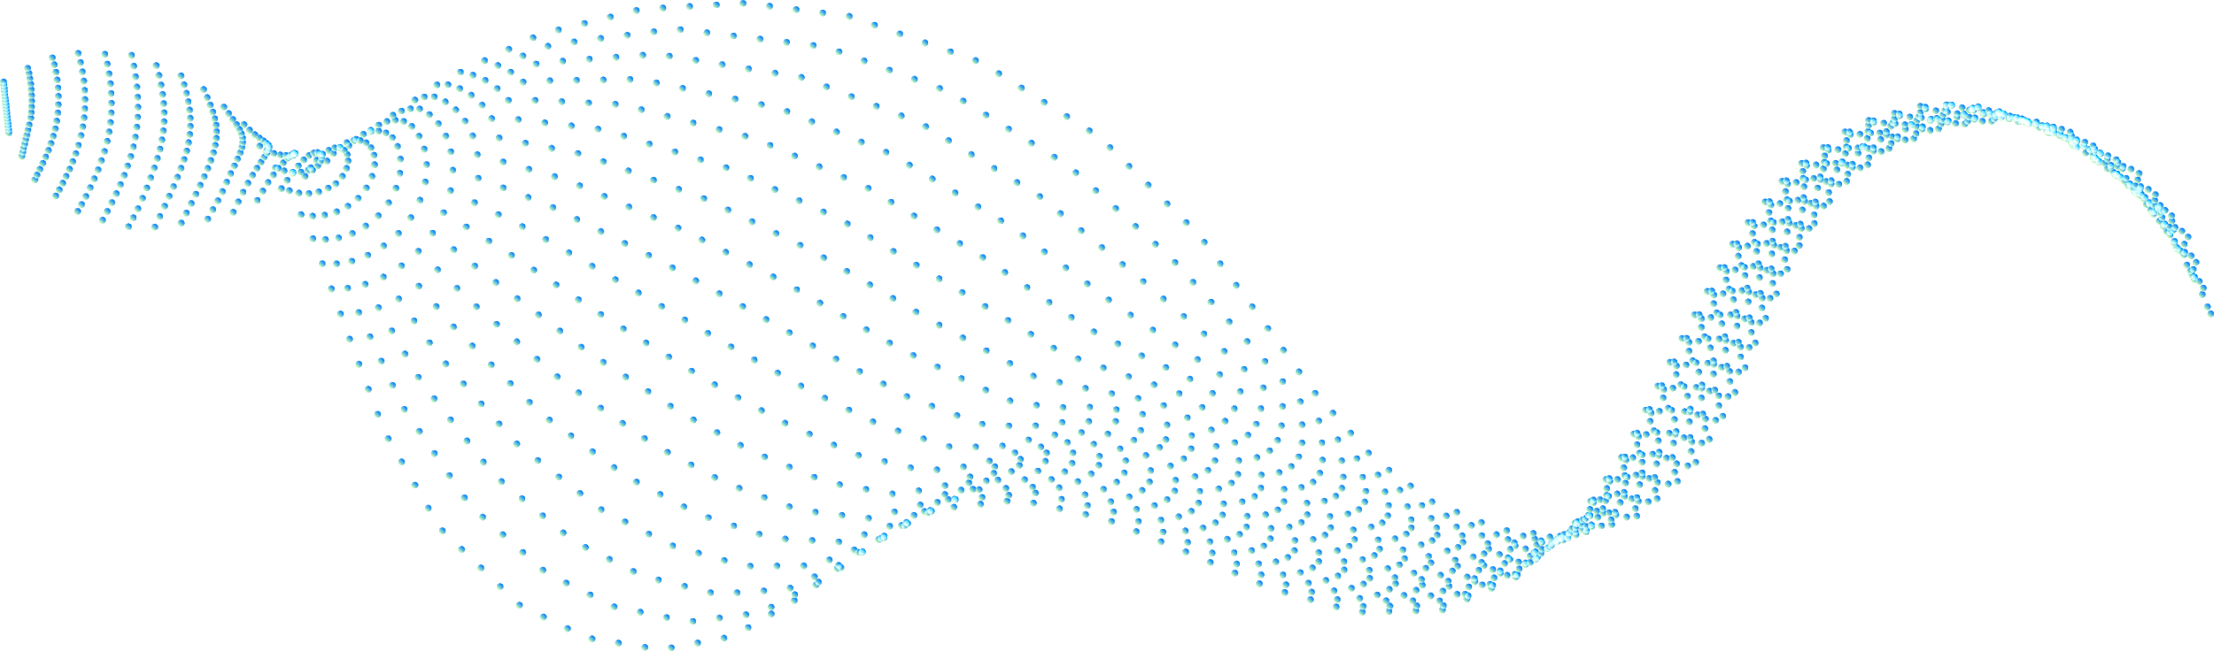



Analysis Libraries
Numpy
Pandas
Matplotlib
Seaborn
Sklearn
Sklearn.utils
Sklearn.svm
Xg boost

Slide 9
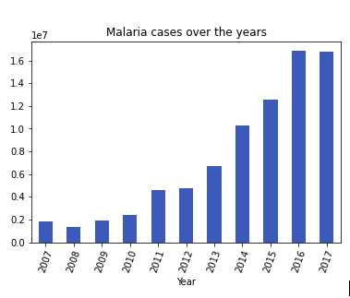
Malaria Cases
The graph reveals that the malaria cases over the years has been rising in the african countries.
This increase shows an Exponential Growth in the malaria cases happening in each year

Slide 10
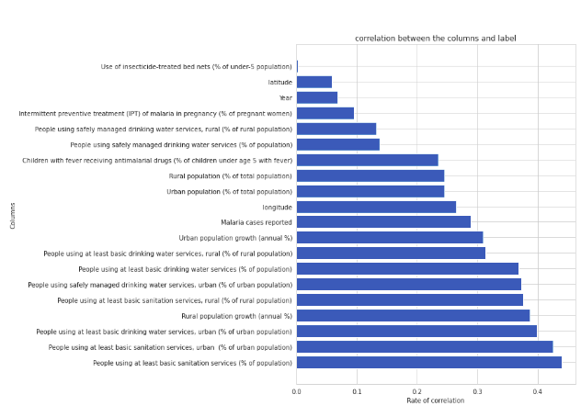
Correlation
The correlation graph enabled us to pick the features we were going to use for our model. The features that had a strong positive correlation with the label were used for modelling..

Slide 11

Analysis Observations
The data follows an Exponential Growth because of how malaria cases are increasing each year
Congo Democratic Republic had the most Malaria incidences that totaled to 16,821,130 cases
2016 had the highest number of Malaria cases
Basic sanitation strongly influences the malaria incidences

Slide 12
MODEL OBSERVATIONS
The algorithm chosen for our model was linear regression reason being we wanted to predict the incidences of malaria cases ,which is our target prediction value based on independent values that we used as the features.
Our model had an accuracy of 0.940659526450512
From our model we were able to derive predicted values based on our features and came up with with a table to compare the two.
To test for specific situations ,we printed out our test data with the actual incidence at the end and the predicted at the beginning.

Slide 13
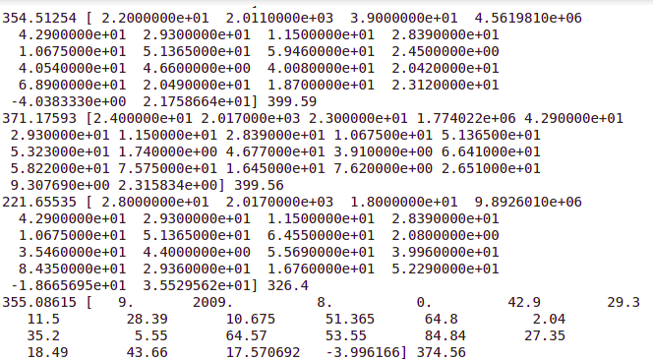
TEST DATA WITH SPECIFIC PREDICTIONS
The image below represents the test data with the actual incidence at the end and the predicted at the beginning.

Slide 14
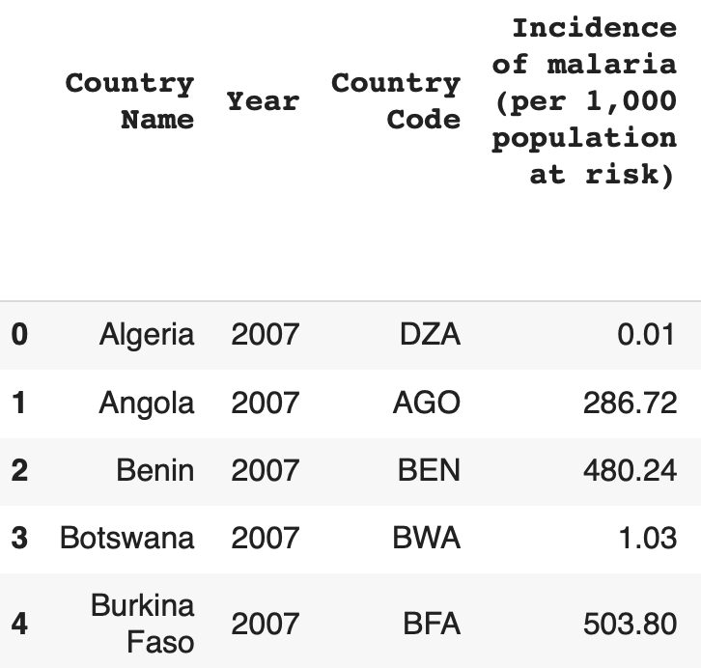
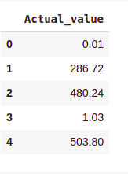
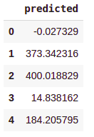
MODEL OBSERVATIONS
The following are observations from our model. With the this we can see that there is need to find methods of lowering the incidences of malaria in Africa within the next year by deploying different protective measures.
Below is a representation of the current incidences of malaria and the prediction from the model.

Slide 15
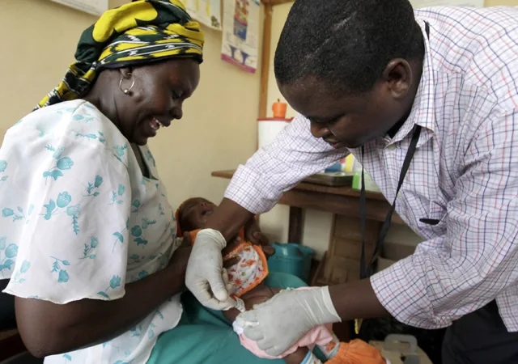
Recommendations
According to our predictions in our dataset we came up with the following recommendations that need to be implemented by December 2021
Clearing Stagnant water around places that humans live so as to disrupt mosquito breeding grounds
Working with local Government communities and hospitals to provide mosquito nets for the community to act as barrier nets from vectors especially children who can’t defend themselves.
Encouraging the Government to partner with pharmaceutical companies to provide malaria drugs in Congo since it is the country with the largest number of malaria cases
Educating the public on ways to mitigate the issue by encouraging the use of mosquito repellents and spraying insecticides in their homes so as to make them more informed and educated on their health choices.

Slide 16
REFERENCE DOCUMENTATION
[1]"Malaria in Africa - UNICEF DATA", UNICEF DATA, 2021. [Online]. Available: https://data.unicef.org/topic/child-health/malaria/. [Accessed: 26- Apr- 2021].
[2]R. Snow and J. Omumbo, "Malaria", Ncbi.nlm.nih.gov, 2021. [Online]. Available: https://www.ncbi.nlm.nih.gov/books/NBK2286/. [Accessed: 26- Apr- 2021].
[3]M. Roser and H. Ritchie, "Malaria", Our World in Data, 2021. [Online]. Available: https://ourworldindata.org/malaria. [Accessed: 26- Apr- 2021].
[4]"Malaria", WHO | Regional Office for Africa, 2021. [Online]. Available: https://www.afro.who.int/health-topics/malaria. [Accessed: 26- Apr- 2021].
[5]"CDC - Malaria - Malaria Worldwide - Impact of Malaria", Cdc.gov, 2021. [Online]. Available: https://www.cdc.gov/malaria/malaria_worldwide/impact.html. [Accessed: 26- Apr- 2021].
[6]"About Malaria | RBM Partnership", Endmalaria.org, 2021. [Online]. Available: https://endmalaria.org/about-malaria.
[7]"Message from the WHO Regional Director for Africa, Dr. Matshidiso Moeti, on World Malaria Day 2021 - World", ReliefWeb, 2021. [Online]. Available: https://reliefweb.int/report/world/message-who-regional-director-africa-dr-matshidiso-moeti-world-malaria-day-2021. [Accessed: 28- Apr- 2021].

Slide 17
The End!!!

